Slide 1
http://www.vidyanidhi.com/
ketkiacharya.net@gmail.com
Ketki Acharya
From: SM VITA ATC of CDAC
9769201036
ketkiacharya.net@gmail.com

Slide 2
Data Type
With Object functionality

Slide 3
Primitive data type
using System;
namespace BasicDataTypes
{ class Program
{
static void Main( string[] args )
{ int myInt = 0;
string myString;
myString = "This is my character data";
// Declare 3 bools on a single line.
bool b1 = true;
// Use System data type to declare a bool.
System.Boolean b2 = false;
Console.WriteLine("Your data: {0}, {1}, {2}, {3}",myInt, myString, b1, b2);
}
}
}
In c# following data type are same written in two ways
sbyte (System.SByte)
byte (System.Byte) 0-255
short (System.Int16) -32768 - +32767
ushort (System.UInt16) 0-65535
int (System.Int32)
uint (System.Uint32)
long (System.Int64)
ulong (System.Int64)
float (System.Single)
double (System.Double)
decimal (System.Decimal)
char (System.Char)-
bool (System. Boolean)
date (System.DateTime)

Slide 4
Can we use new key word for value type?
using System;
namespace BasicDataTypes
{
class Program
{
static void Main( string[] args )
{
bool b = new bool(); // Set to false.
int i = new int(); // Set to 0.
double d = new double(); // Set to 0.
d = 12.0;
double pd =12.0;
DateTime dt = new DateTime(); // Set to 1/1/0001 12:00:00 AM
Console.WriteLine("{0}, {1}, {2}, {3} {4}", b, i, d,pd, dt);
//false 0 12 12 01/01/0001 00:00:00
Console.WriteLine("12.Equals(12) = {0}", d.Equals(12.0));//true
Console.WriteLine("12==12 = {0}", d == pd);//true
Console.WriteLine("12. GetHasCode will be", d.GetHasCode());//12
Console.WriteLine("12.ToString", d.ToString());//12 as string
Console.WriteLine();
}
}
}
As you know all primitive data type are internally structure.
Recollect you can not use no args constructor in structure as it is reserved for frame work.
Here b will be initialised to false and i will be intialised to 0
Generally we do not use new key word with primitive data type but it is possible to use.
Where these data is going to reside -stack or heap?
Ans: It will resides on stack
Is it using boxing -un boxing ?
Ans: No.
How primitive type can use Equals, GetHashCode, ToString method?
Ans: All primitive data type are derived from abstract class “ValueType” which again derived from Object class. This Object class has virtual methods Equals, GetHashCode and Tostring. All these methods are overridden in primitive types
== operator will check value for primitive and string data type otherwise it will check reference (arrow) == operator is overloaded in string class and in primitive type

Slide 5
Lets prove: Every things are derived from Object class
In this example please focus on output, as I am using some advance methods and property just to show that even primitive data are derived from “ValueType” and “ValueType” is derived from Object. This is totally different compare to java.
All Reference type data are derived from Object class
using System;
namespace ConsoleApplication1
{
class Employee //( : Object )
{ public int salary;
}
class Program
{
static void Main(string[] args)
{
int a=5;
Console.WriteLine("{0}",a.GetType()); //System.Int32
Console.WriteLine("{0}", a.GetType().BaseType); //System.valueType
Console.WriteLine("{0}", a.GetType().BaseType.BaseType );//System. ObjectType
Employee ob = new Employee(); //reference type data
Console.WriteLine("{0}", ob.salary .GetType()); //System.Int32
Console.WriteLine("{0}", ob.GetType() );//name of class(Employee)
// observe datatype of ob is Employee
Console.WriteLine("{0}", ob.GetType().BaseType);//System. Object
//parent of Employee is Object
}
}
}
In this example we have used predefine methods GetType.
GetType Method is define in Object class who’s job is to return datatype[internally this method return reference of Type class]
BaseType is property(observe no () –parentheses ) in Type class. We will learn property as we go ahead[it is similar to getter setter method ]. BaseType property will return the name of the parent class
When you write class Employee{} , Compiler is providing like this
class Employee:Object
{ }
Here : means ( inherit )
For better understanding in this example just type in editor ob . and observe method displayed. Is this methods have you written in your class? Answer is No . so how it is showing GetType(), GetHashCode(), ToString().These are methods define in parent class ie Object class which is inherited by Employee class.

Slide 6
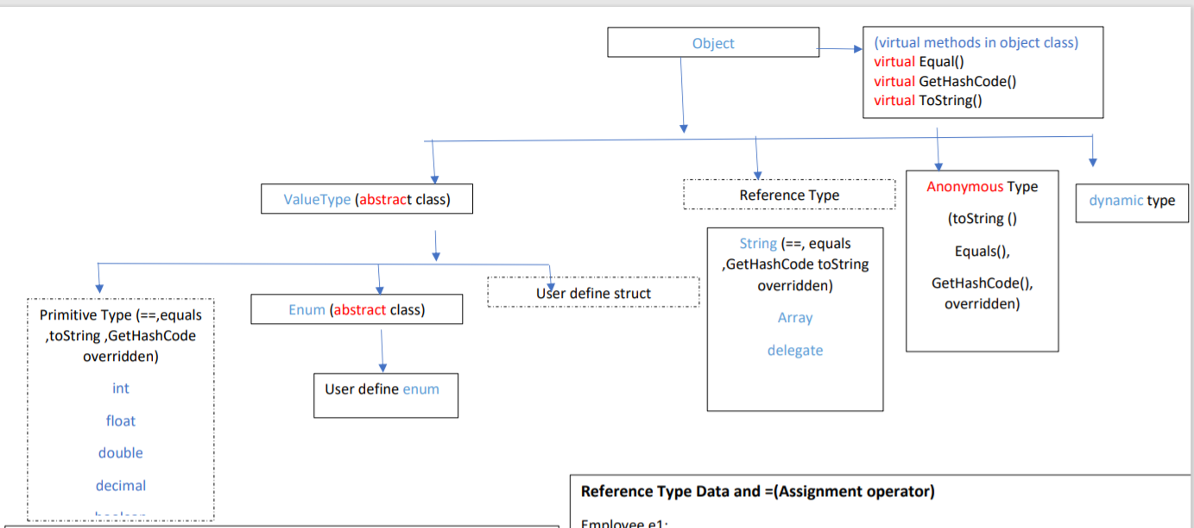
var

Slide 7
var key word
var is Implicitly Typed Variables. Means you may not use data type but datatype will be inferred when you assign value. In our example
var name = "Bugs Bunny";
Here before name variable we have written var key word and not string. But compiler will able to understand that it is string as you are assigning value at the time of declaration. That is why it is called Implicitly Typed Variables
It is strongly type data, ie you can not change data type
For eg
var name = "Bugs Bunny";
name=9; //this will give error as you can not assign int to a string variable
Who is the parent class for var?
Ans: Object
using System;
namespace Basics
{
class TypeInference
{
static void Main(string[] args)
{
var name = "Bugs Bunny";
var age = 25;
var isRabbit = true;
Type nameType = name.GetType(); //return data type
Type ageType = age.GetType();
Type isRabbitType = isRabbit.GetType();
Console.WriteLine("name is type " + nameType.ToString());
Console.WriteLine("age is type " + ageType.ToString());
Console.WriteLine("isRabbit is type " + isRabbitType.ToString());
}
}
}

Slide 8
Rules for var key words
Implicit typing applies only to local variables in a method or property scope.
It is illegal to use the var keyword to define return values, parameters, or field data of a custom type.
For example, the following class definition will result in various compile-time errors:
class ThisWillNeverCompile
{
// Error! var cannot be used as field data! Ie instance member
private var myInt = 10;
// Error! var cannot be used as a return value
// or parameter type!
public var MyMethod(var x, var y)
{ }
}
Also, local variables declared with the var keyword must be assigned an initial value at the exact time of declaration and cannot be assigned the initial value of null. This last restriction should make sense, given that the compiler cannot infer what sort of type in memory the variable would be pointing to based only on null.
// Error! Must assign a value!
var myData;
// Error! Must assign value at exact time of declaration!
var myInt;
myInt = 0;
// Error! Can't assign null as initial value!
var myObj = null;

Slide 9
Rules for var key words
It is permissible, however, to assign an inferred local variable to null after its initial assignment (provided it is a reference type).
// OK, if SportsCar is a reference type!
var myCar = new SportsCar();
myCar = null;
Furthermore, it is permissible to assign the value of an implicitly typed local variable to the value of other variables, implicitly typed or not.
// Also OK!
var myInt = 0;
var anotherInt = myInt;
string myString = "Wake up!";
var myData = myString;
Also, it is permissible to return an implicitly typed local variable to the caller, provided the method return type is the same underlying type as the var-defined data point.
static int GetAnInt()
{
var retVal = 9;
return retVal;
}
Implicit Typed Data Is Strongly Typed Data Be very aware that implicit typing of local variables results in strongly typed data. Therefore, use of the var keyword is not the same technique used with scripting languages (such as JavaScript or Perl) or the COM Variant data type, where a variable can hold values of different types over its lifetime in a program (often termed dynamic typing).

